Slide 1
HEART DISEASE PREDICTION USING MACHINE LEARNING ALGORITHM
TEAM MEMBERS: JEEVA M (811721243019)
SHANKARANARAYANAN R (811721243051)
THINESH M(811721243058)
HARRISH GOKUL M (811721243301)
Team guide name: Mrs. R.Reetha Jeyarani, M.E.(ASSISTANT PROFESSOR)

Slide 2
ABSTRACT
Heart disease remains a significant global health concern, necessitating advanced predictive tools for early risk assessment and prevention.
Machine learning algorithms have emerged as a promising solution to this challenge. This paper presents an overview of machine learning applications in heart disease prediction.
It discusses the key algorithms used, their advantages, and limitations. Furthermore, the paper details the essential steps in creating and validating predictive models for heart disease, emphasizing their potential for personalized risk assessment and intervention.
The ethical and privacy considerations in healthcare-based machine learning are addressed, and the evolving research landscape and challenges in this field are explored.
Leveraging machine learning for heart disease prediction has the potential to transform cardiology by enabling more accurate risk assessment and ultimately improving patient outcomes and public health.

Slide 3
INTRODUCTION
Machine learning algorithms can be trained on historical data to recognize patterns and relationships between these risk factors and the occurrence of heart disease.
They can then use this knowledge to make predictions for new or unseen cases. This has the potential to revolutionize the field of cardiology by enabling more accurate and personalized risk assessments, ultimately leading to better preventive strategies and early interventions.
This application of machine learning in heart disease prediction has the potential to benefit healthcare professionals and patients alike.
Healthcare providers can use these models to identify high-risk individuals, prioritize preventive measures, and allocate resources efficiently.
Patients can gain a better understanding of their own risk factors and take proactive steps to reduce their risk of heart disease, leading to a healthier and longer life.

Slide 4
In this context, this article will explore the various machine learning algorithms commonly used in heart disease prediction, their advantages and limitations, and the steps involved in building and validating predictive models.
Additionally, we will discuss the ethical and privacy considerations associated with using machine learning in healthcare, as well as the ongoing research and challenges in the field of heart disease prediction.
Overall, the use of machine learning in heart disease prediction holds great promise for improving the diagnosis and prevention of this prevalent and life-threatening condition.

Slide 5
Literature survey
Title:Random forest based heart disease prediction
Authour: preethi sondhi
Published year:2021
Technique used :naïve bayes,support vector machine ,random forest
Advanatages:
by using random forest algorithm has been found to have 95.08% more precision compared to other algorithms.
Disadvantages:Random Forest is an ensemble of decision trees, and the combination of multiple trees can result in a relatively complex model. This complexity can lead to longer training times and increased computational overhead, especially when dealing with large datasets.

Slide 6
Title: Study of heart disease prediction using cnn algorithm
Authour: D.kumari
Published year:2021
Technique used : a random forest with BI-LSTM
Advantages:
in this report ,suggested a random forest with Bi-LSTM as hybrid approach has been found to have more accurate as compared to other algorithms.
Disadvantages:
CNNs are data-hungry models, and they require a large volume of labeled data for training. Obtaining sufficient labeled medical imaging data, especially for specific heart disease conditions, can be a significant challenge. Small or imbalanced datasets can lead to overfitting or suboptimal model performance.

Slide 7
Title: Prediction of heart disease using multilayer perceptron neural network
Authour: jayashri S.sonawane,D.patil
Published : 2014
Technique used: Back propagation algorithm to predict
Advantages:
MLPs are capable of modeling complex, non-linear relationships between input features and heart disease outcomes. This flexibility allows them to capture intricate patterns in the data.
Disadvantages:
MLPs require a large amount of labeled data for training, which can be challenging to obtain in healthcare, especially for rare conditions or when expert labeling is required.

Slide 8
We produce an enhanced performance level with an accuracy level of 88.7% through the prediction model for heart disease with the hybrid random forest with a linear model (HRFLM).
We produce an enhanced performance level with an accuracy level of 88.7% through the prediction model for heart disease with the hybrid random forest with a linear model (HRFLM).
Title: effective heart disease prediction using hybrid machine learning techniques
Authour: senthilkumar mohan, chandrasegar thirumalai,Gautam Srivastava
Published:2019
Techiniques:hybrid random forest with a linear model(HRFLM)
Advantages:
It produce an enhanced performance level with an accuracy level of 88.7% through the prediction model for heart diseasr with the hybrid random forest with a linear model(HRFLM)
Disadvantages:
Hybrid models can be significantly more complex than individual machine learning models. Integrating multiple algorithms or models requires careful design and can lead to complex architectures that are challenging to understand and maintain

Slide 9
Title: heart disease detection using hybrid machine learning and IOT
Authour: tanmay salunke ,Pavankumar jagade
Published : may(2023)
Techniques:leverage ML techniques to identify significant features that can improve accuracy of heart disease prediction
Advantages:
By using ml techniques achieving a superior level of performance with an accuracy rate of 88.7% for predicting heart disease.
Disadvantages:
Integrating machine learning models with IoT devices and the associated data streams can be complex. Ensuring seamless communication and data flow between IoT sensors and machine learning algorithms requires careful engineering

Slide 10
EXISTING SYSTEM:
Electronic Health Records (EHRs): EHRs are a foundational component of modern healthcare. They store patient data, including medical history, test results, medications, and demographics.
Machine learning algorithms can leverage EHR data for predictive modeling, allowing healthcare providers to identify patients at risk of heart disease based on their medical records.
Diagnostic Tests: Diagnostic tests, including electrocardiograms (ECGs or EKGs), echocardiography, and stress tests, are used to diagnose heart conditions and assess the heart's function.
Machine learning models can be trained on the results of these tests to aid in diagnosis and prognosis.

Slide 11
Proposed system
Decision Support Systems: The system would provide decision support tools for healthcare professionals. These tools would assist in interpreting machine learning predictions and guide clinicians in making informed decisions regarding patient care and interventions.
Advanced Machine Learning Models: The proposed system would incorporate state-of-the-art machine learning models, including deep learning techniques like convolutional neural networks (CNNs) for image data (e.g., medical imaging) and recurrent neural networks (RNNs) for time series data (e.g., ECG data).
These models would be designed to analyze a wide range of patient data, including medical records, diagnostic test results, genetic information, lifestyle data, and wearable device data.

Slide 12
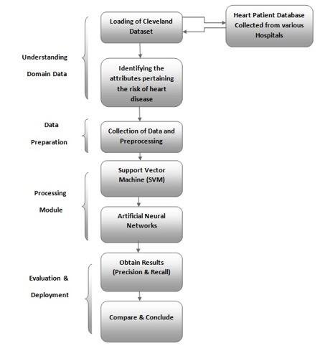
System architecture

Slide 13
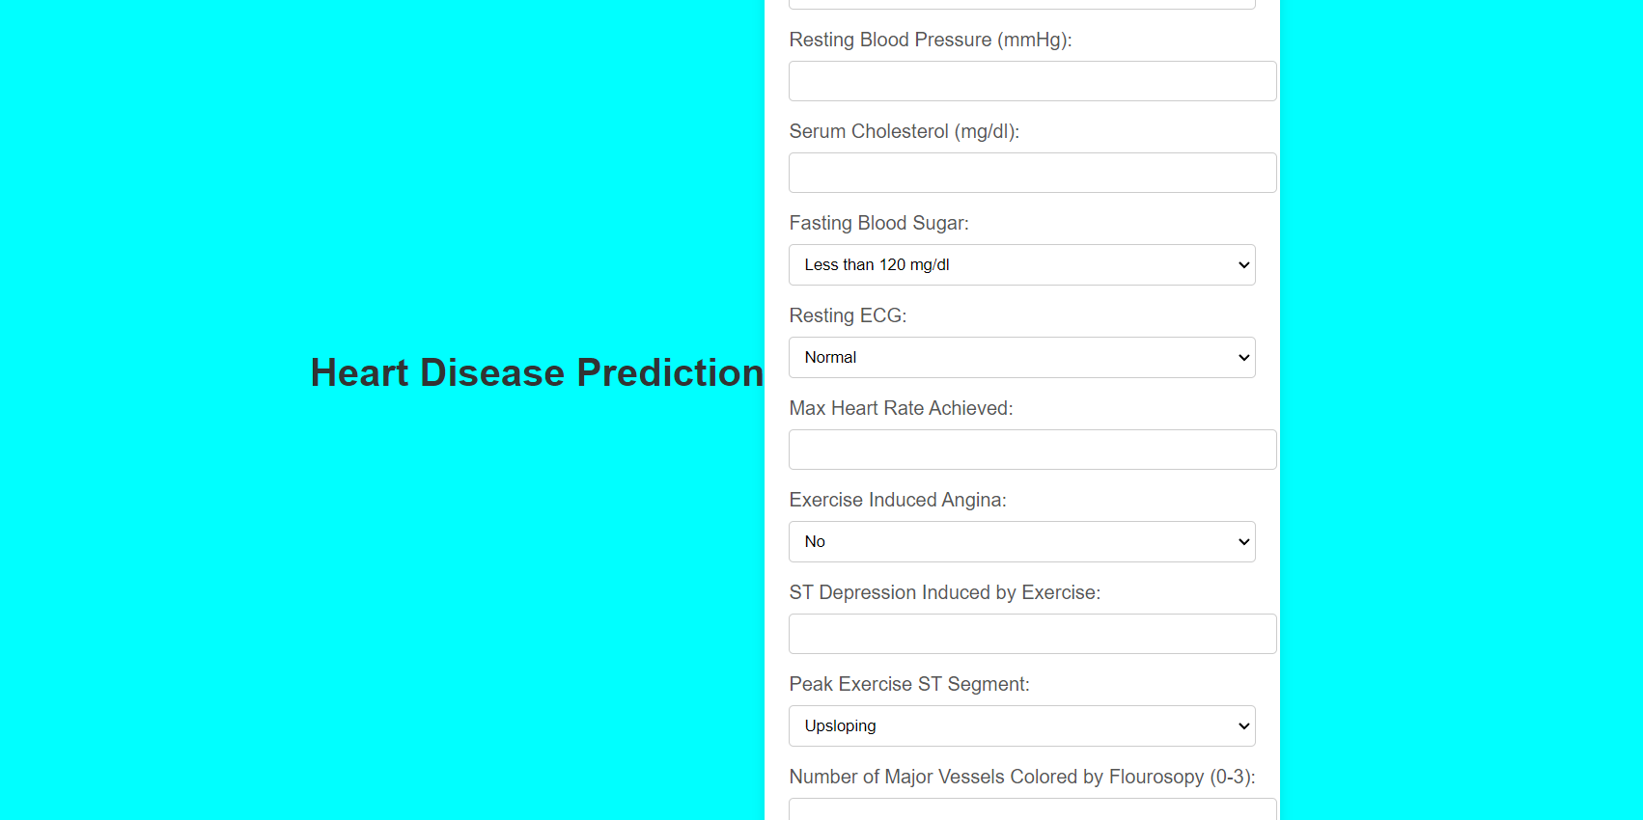
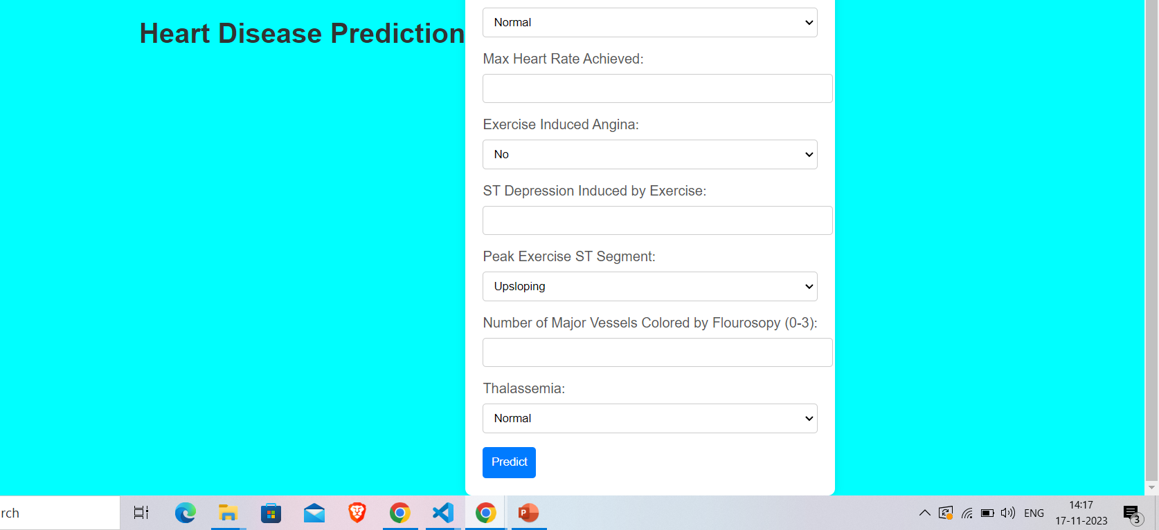

Slide 14
